Slide 1
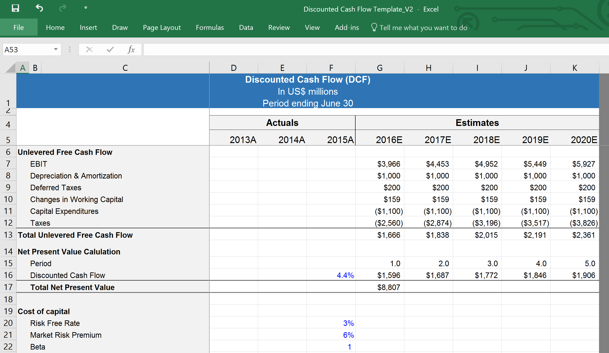
Discounted Cash Flow Analysis
Confidential
By Ex-Deloitte Management Consultants and Investment Bankers

Slide 2
Introduction
A Discounted Cash Flow (DCF) Analysis is a valuation method used to estimate the attractiveness of an investment opportunity. DCF analysis uses future free cash flow projections and discounts them to arrive at a present value estimate, which is used to evaluate the potential for investment.
You can conduct a Discounted Cash Flow (DCF) Analysis by following these 5 steps:
1
Estimate the Total Unlevered Free Cash Flow using our excel template
2
Calculate the Total Net Present Value of the Total Unlevered Free Cash Flow using our Excel template
3
Calculate the Weighted Cost of Capital using our Excel template
4
Calculate the terminal value with both the EBIDTA and PERPETUITY methods using our Excel template
5
Calculate the DCF Total Valuation with both the EBIDTA and PERPETUITY methods using our Excel template

Slide 3

Step 1 - Estimate the Total Unlevered Free Cash Flow using our excel template
Adjust the actual and projected years. Taking 3 historical years and 5 projected years is usually a good trade-off between being comprehensive and effective
Adjust if required the line items depending on the context of the company
Ideally all these figures should be pulled from either the income statement or the Balance sheet

Slide 4
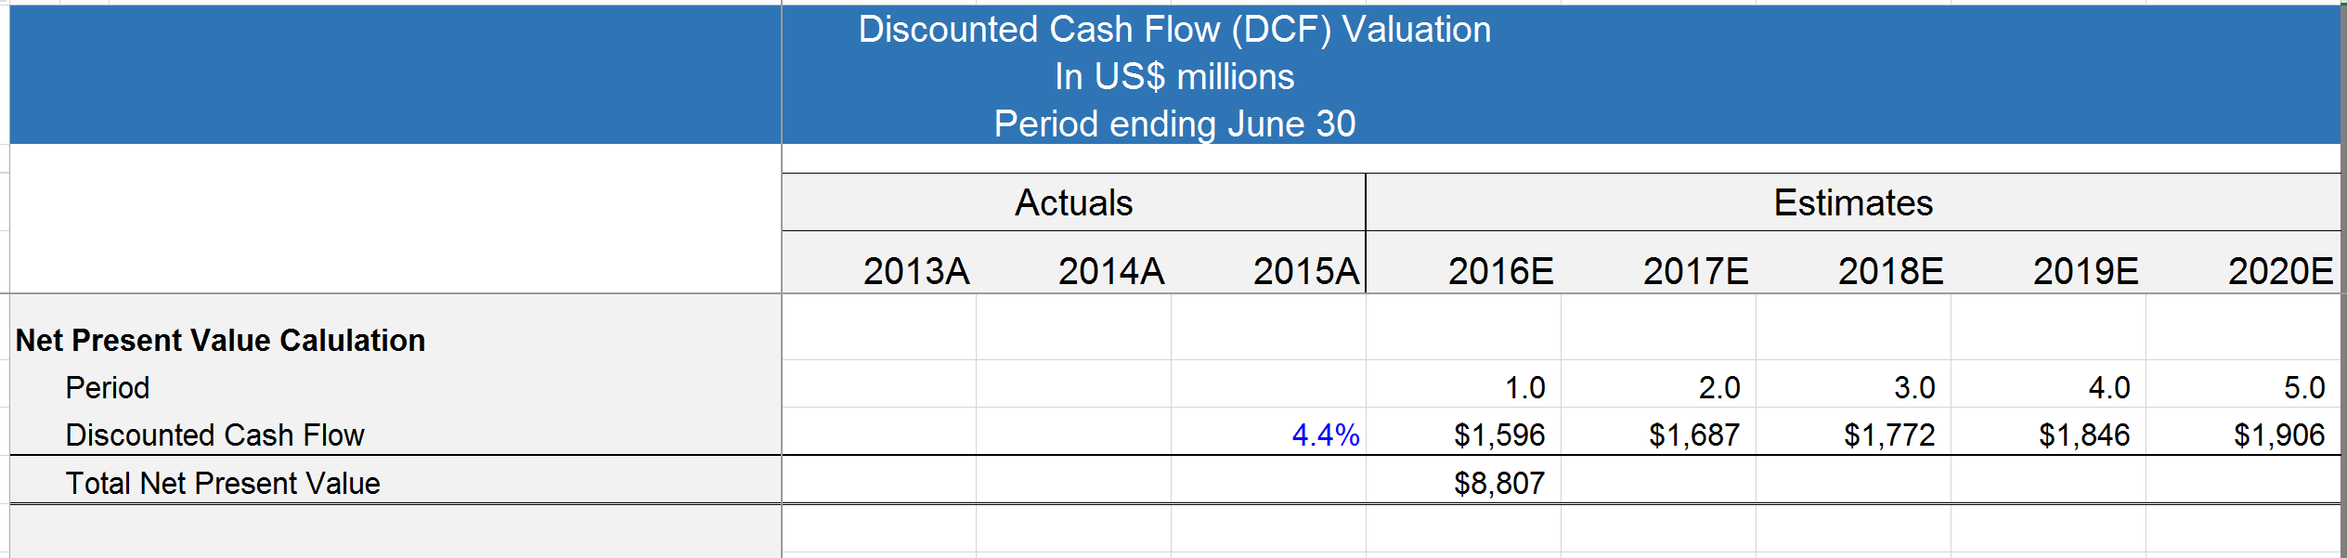
Step 2 - Calculate the Total Net Present Value of the Total Unlevered Free Cash Flow using our Excel template
The percentage to discount the Total Unlevered Free Cash Flow will be calculated in the next step

Slide 5
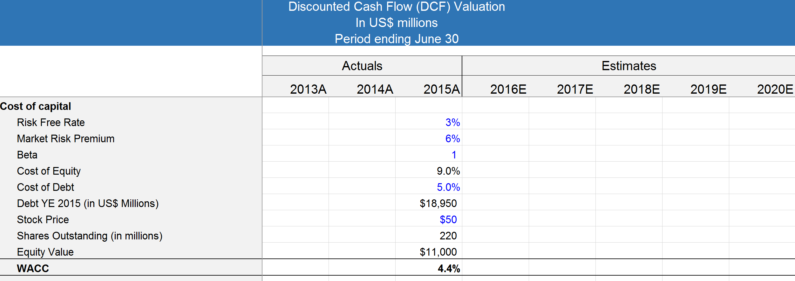
Step 3 - Calculate the Weighted Cost of Capital using our Excel template
The WACC can now be used to properly discount the Unlevered Free Cash Flow

Slide 6
Step 4 - Calculate the terminal value with both the EBIDTA and PERPETUITY methods using our Excel template

Slide 7
Step 5 - Finally, calculate the DCF Total Valuation with both the EBIDTA and PERPETUITY methods using our Excel template

Slide 8

Interested in more than 1 Toolkit? Access all our Toolkits for half the price with our Gold Access
Gold Access
Click here to learn more

Slide 9

Thanks for your attention!
www.domontconsulting.com

